Slide 1
Dynamic Array
- https://chogahui05.blog.me/221210436338
- https://www.youtube.com/watch?v=I4_uFyjWZn4
Linked List
- https://www.youtube.com/watch?v=DzGnME1jIwY
Stack
- https://www.youtube.com/watch?v=whVUYv0Leg0
Queue
- https://www.youtube.com/watch?v=W3jNbNGyjMs
Deque (데크)
- http://www.hanbit.co.kr/channel/category/category_view.html?cms_code=CMS3942847236

Slide 2
Dynamic Array
- https://chogahui05.blog.me/221210436338
- https://www.youtube.com/watch?v=I4_uFyjWZn4

Slide 3
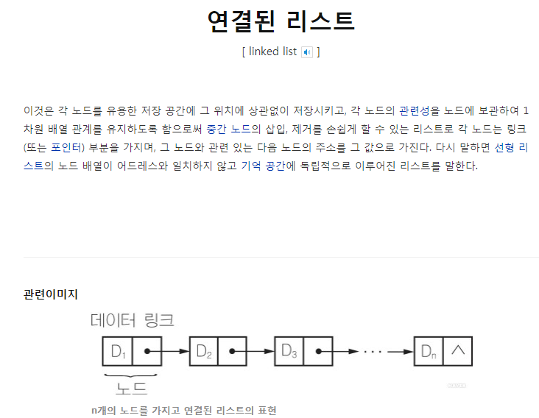
https://www.youtube.com/watch?v=DzGnME1jIwY

Slide 4
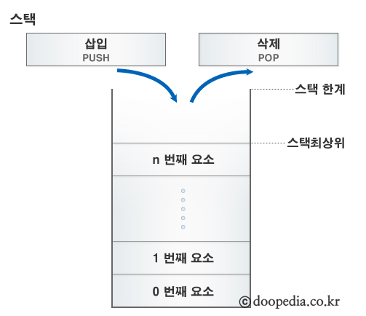
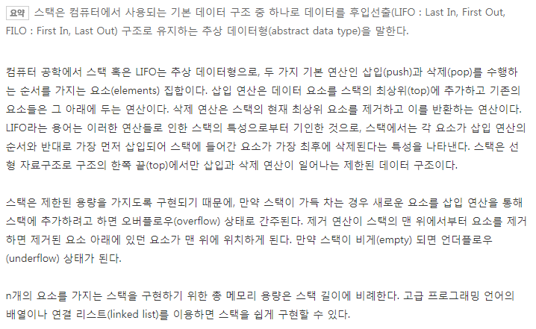
https://www.youtube.com/watch?v=whVUYv0Leg0

Slide 5
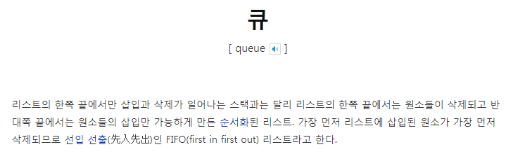
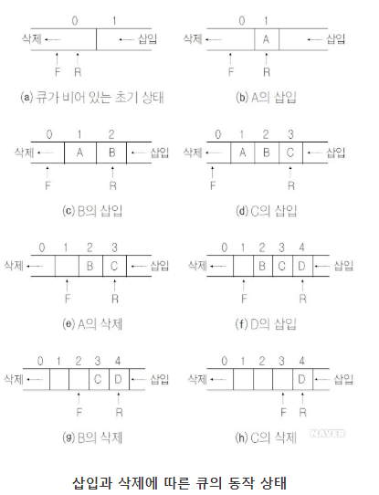
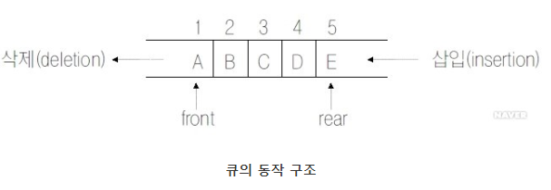
https://www.youtube.com/watch?v=W3jNbNGyjMs

Slide 6
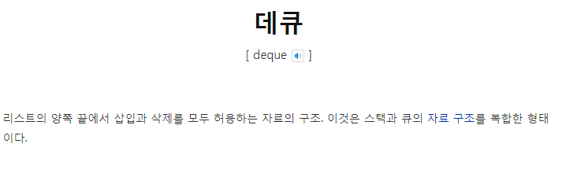
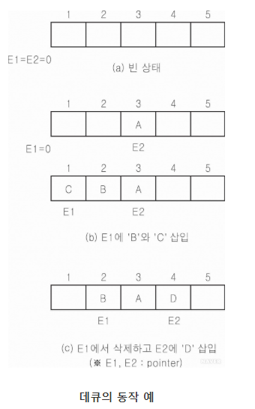
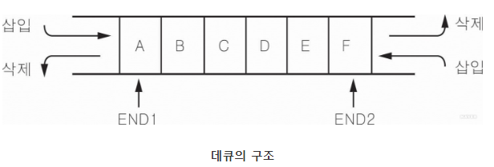
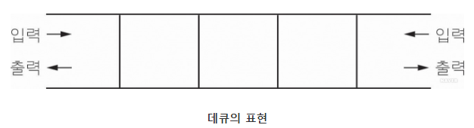
http://www.hanbit.co.kr/channel/category/category_view.html?cms_code=CMS3942847236

